Slide 1
Must-Pick Bombs and Hidden Gems in Outlaws of Thunder Junction
A Magic: The Gathering Draft Analysis
Brad Wicklund 2025

Slide 2
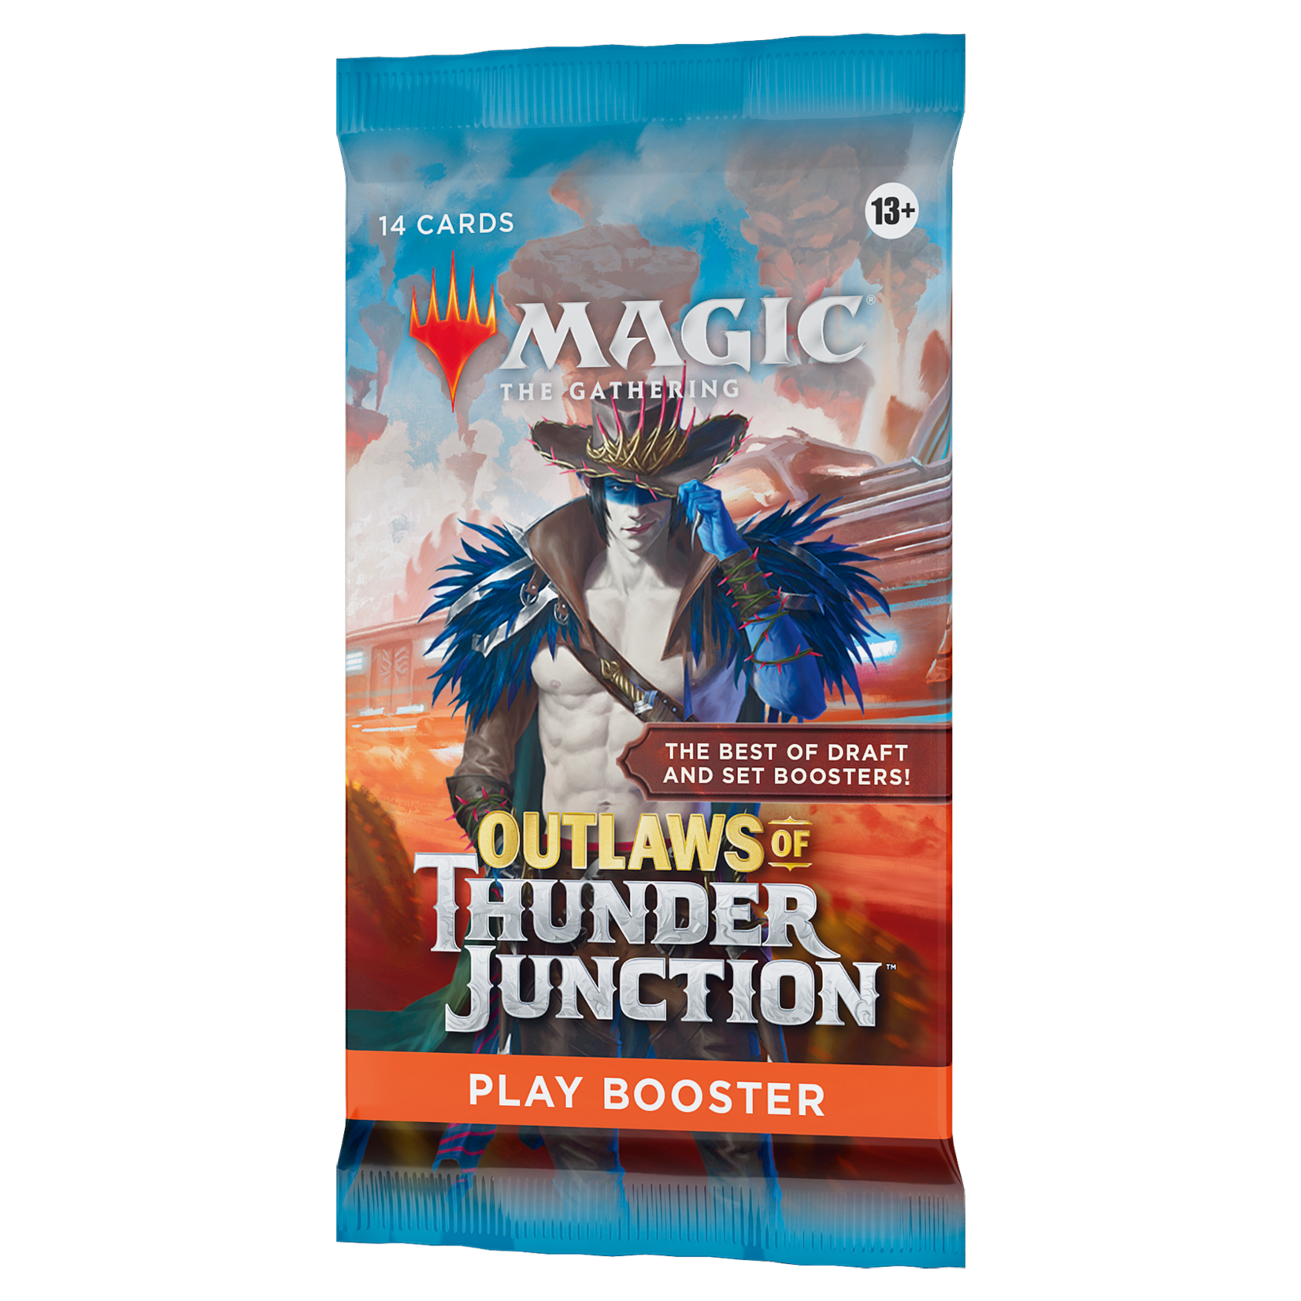
Agenda
Data & Metrics Overview
Identifying “Must-Pick” Bombs
Uncovering Hidden Gems
Draft Strategy Takeaways
Q&A

Slide 3
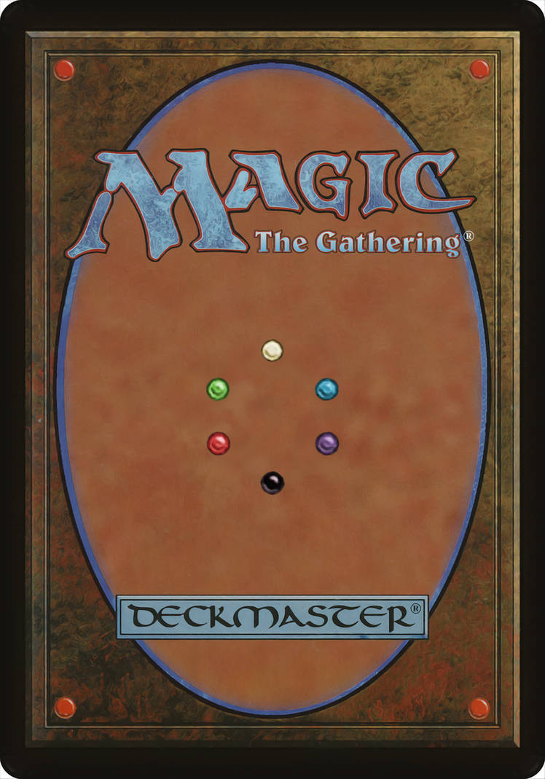
Data Metrics & Overview
Dataset from 17lands
ATA (Average Taken At)
GP WR (Games Played Win Rate)

Slide 4
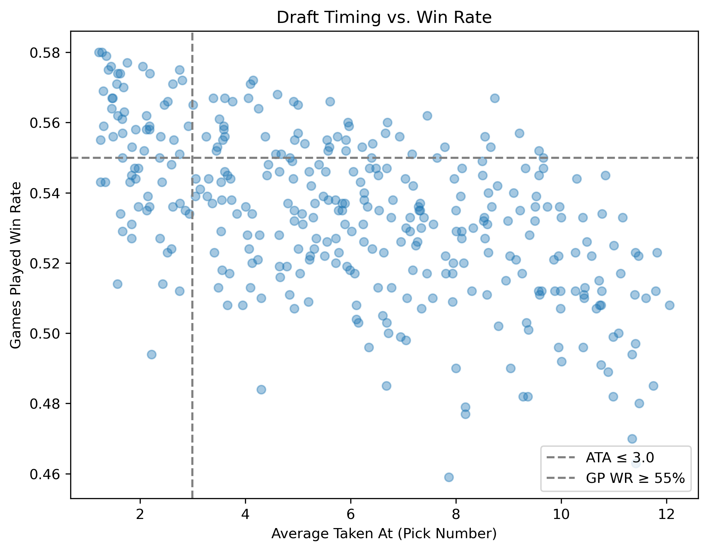

Slide 5
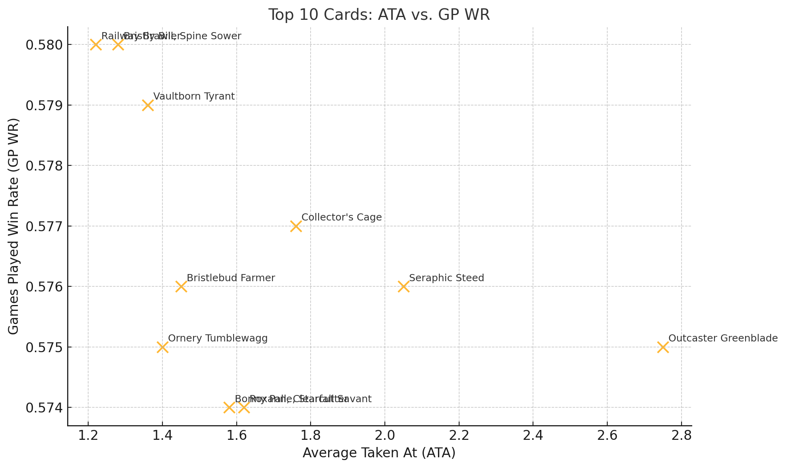
Finding Must-Pick Bombs
ATA ≤ 20th percentile
GP WR ≥ 75th percentile

Slide 6
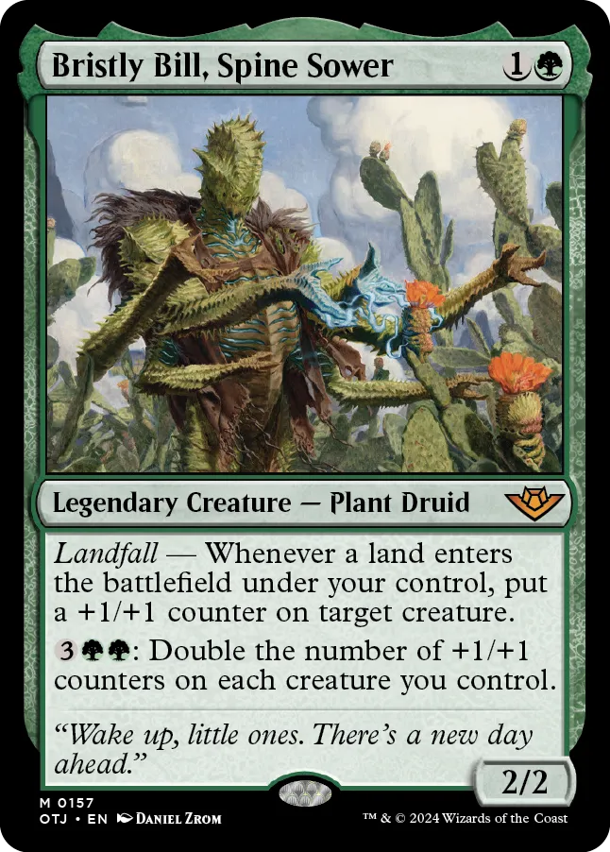
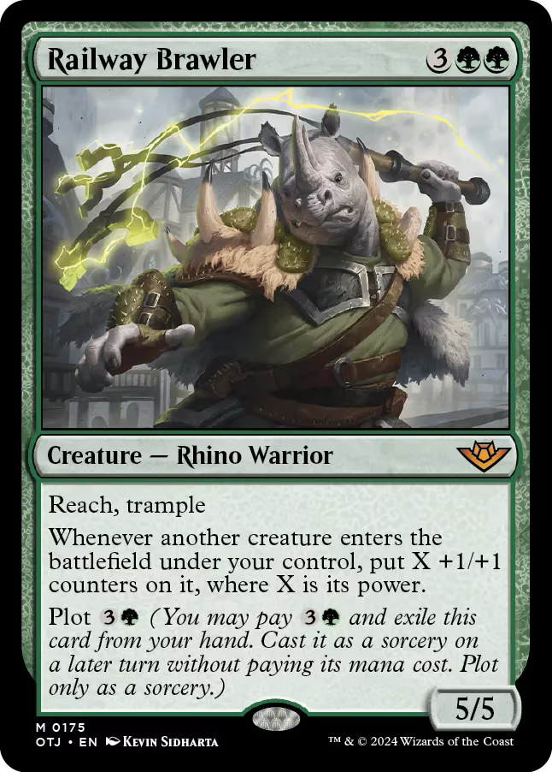
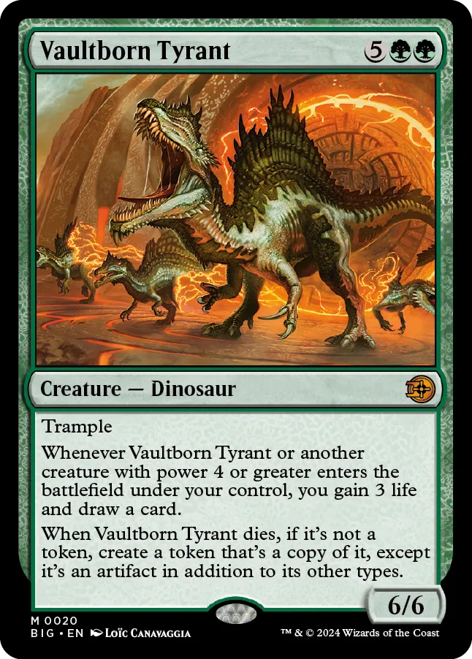
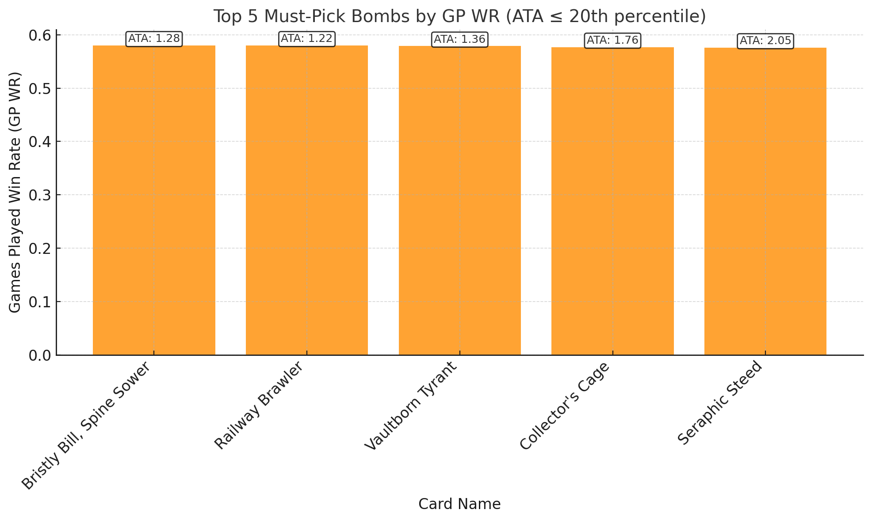
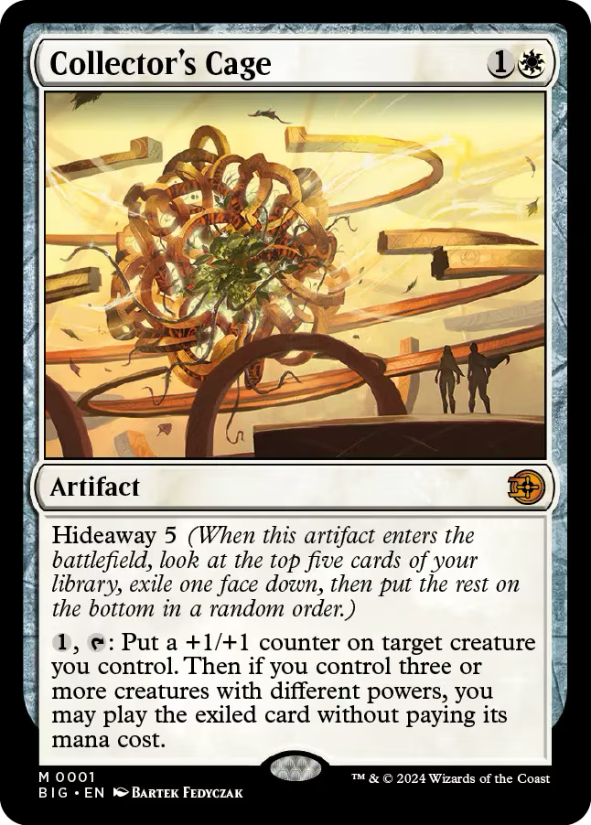
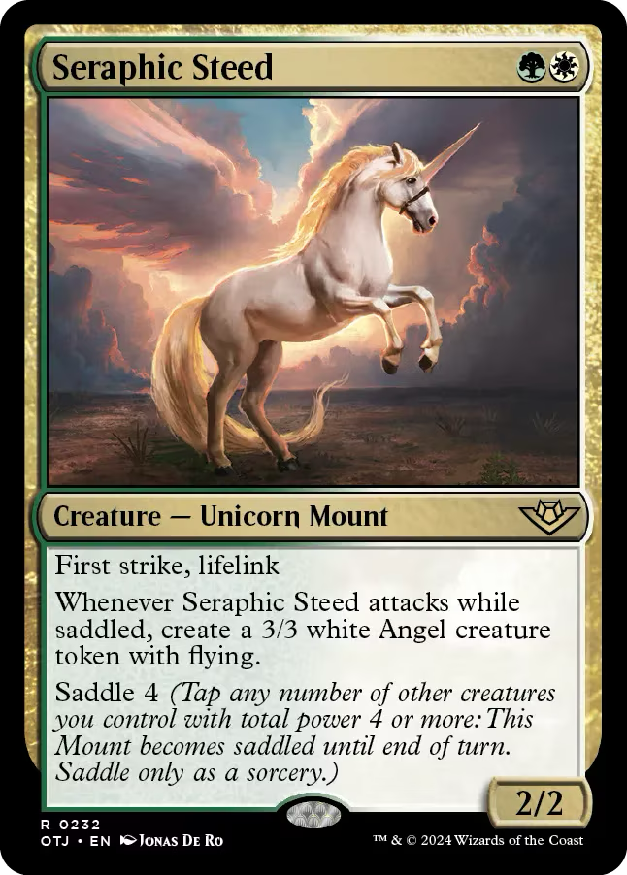
Must-Pick Bombs: Top 5

Slide 7
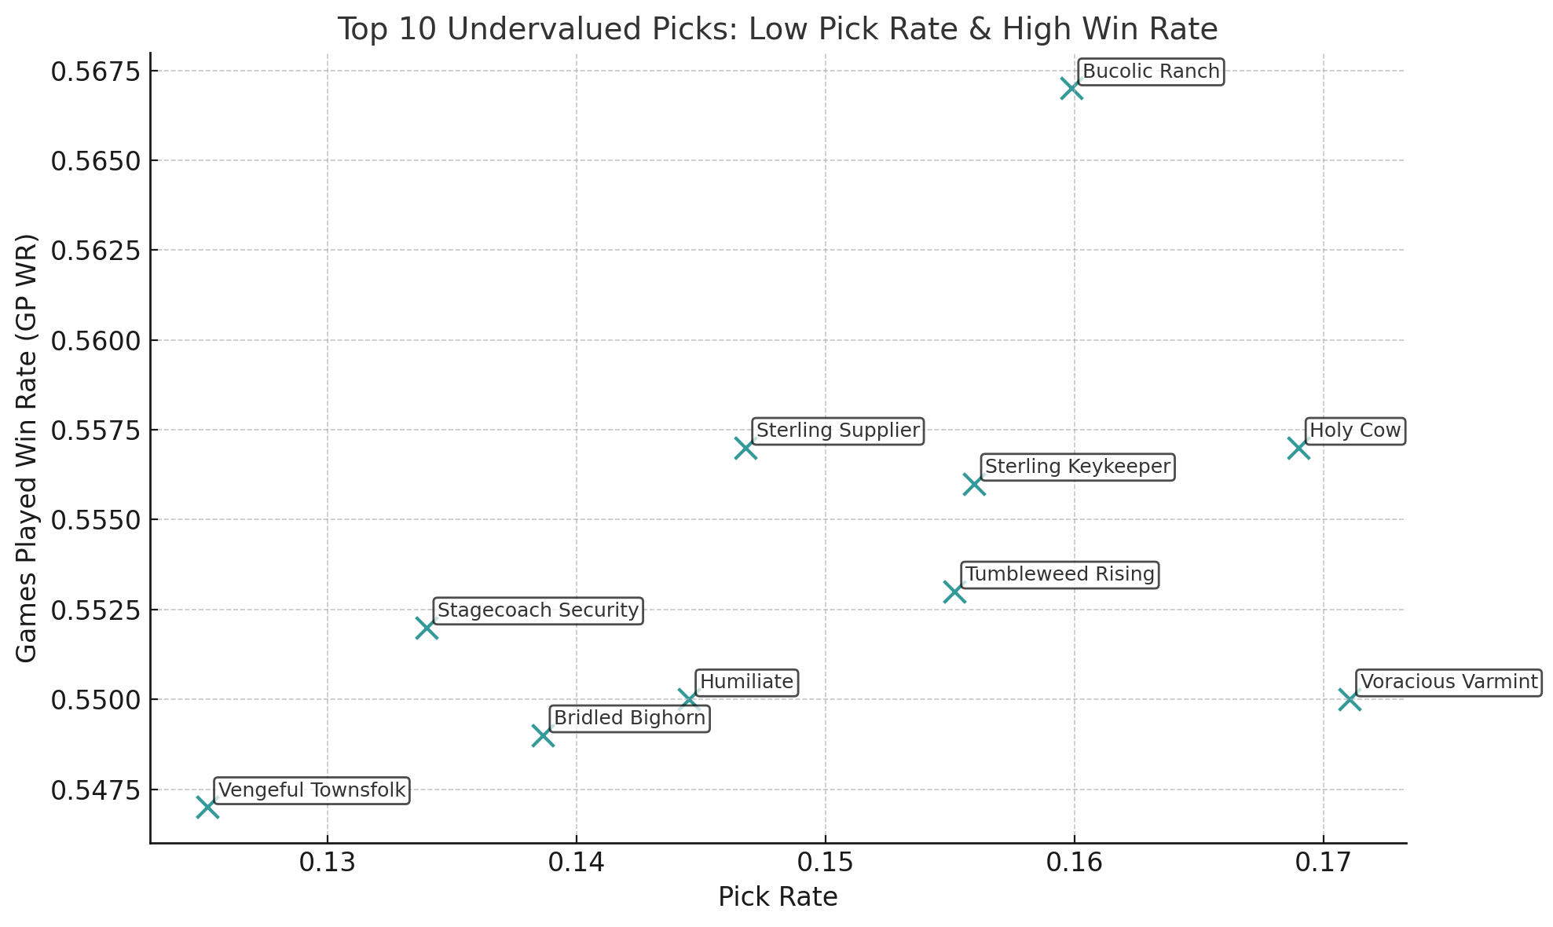
Uncovering Hidden Gems
Pick Rate < median
ATA < median
GP WR > median

Slide 8
Draft Strategy Takeaways
Grab the Bombs
Watch for Hidden Gems
Balance your curve and removal

Slide 9
Q & A

